Slide 1
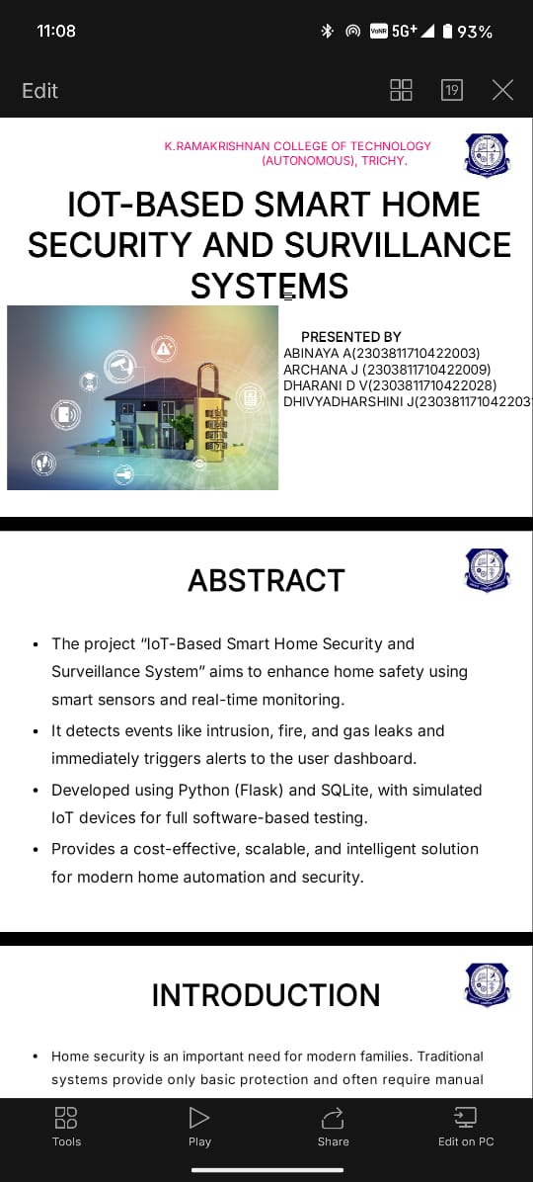
Job Portal System
PRESENTED BY,
SRINIVAS S (2303811710421157)
SHAHRUKESH DM (2303811710421140)
SACHIN KUMAR A (2303811710421132)

Slide 2
ABSTRACT
The project “Job Portal System” aims to simplify the process of applying, reviewing, and managing job applications online.
It allows applicants to register, create profiles, and apply for available job openings, while recruiters can post new jobs, review applications, and shortlist suitable candidates.
Developed using Django (Python Framework) and SQLite Database, this system ensures a user-friendly interface, real-time data management, and efficient tracking of applicants and job posts.

Slide 3
INTRODUCTION
In the modern era, managing job applications manually is time-consuming and prone to errors. Companies often receive hundreds of applications, making it difficult to track and manage candidates effectively.
The Job Application Management System provides a web-based platform that automates this process. It allows job seekers to apply easily and recruiters to filter applications quickly based on skills and qualifications.
The project follows Object-Oriented Analysis and Design (OOAD) principles, using UML diagrams such as use case, class, and sequence diagrams to ensure a clear and scalable architecture.

Slide 4
EXISTING SYSTEM
The existing recruitment systems are either paper-based or rely on multiple third-party job portals that lack customization.
Manual tracking leads to issues like data loss, redundancy, and difficulty in communication between applicants and recruiters.
Existing systems also lack real-time application tracking, automated filtering, and role-based access for users.
As a result, recruiters spend more time managing applications rather than focusing on candidate evaluation.

Slide 5
PROPOSED SYSTEM
Post, edit, and delete job listings.
View and shortlist applicants.
Applicants can :
Create and manage profiles.
Apply for available jobs and track application status.
The system provides secure authentication, real-time updates, and automated notifications via email or dashboard alerts.
Developed using Django, it ensures a robust backend, modular architecture, and easy scalability for future enhancements.

Slide 6
MODULES
1. USER MODULE
Manages registration, login, and profiles.
Provides role-based access for applicants and recruiters.
2. JOB POSTING MODULE
Enables recruiters to add, edit, or delete job listings.
Displays job details such as title, description, skills, and salary.
3. APPLICATION MANAGEMENT MODULE
Allows applicants to apply for jobs and track status.
Recruiters can review and update candidate progress (shortlisted, rejected, hired).

Slide 7
MODULES
4. NOTIFICATION & ALERT MODULE
Sends real-time alerts for application updates and job changes.
Supports email and dashboard notifications.
5. DATABASE MODULE
Stores user, job, and application data in SQLite securely.
Supports data retrieval, reports, and analytics.

Slide 8
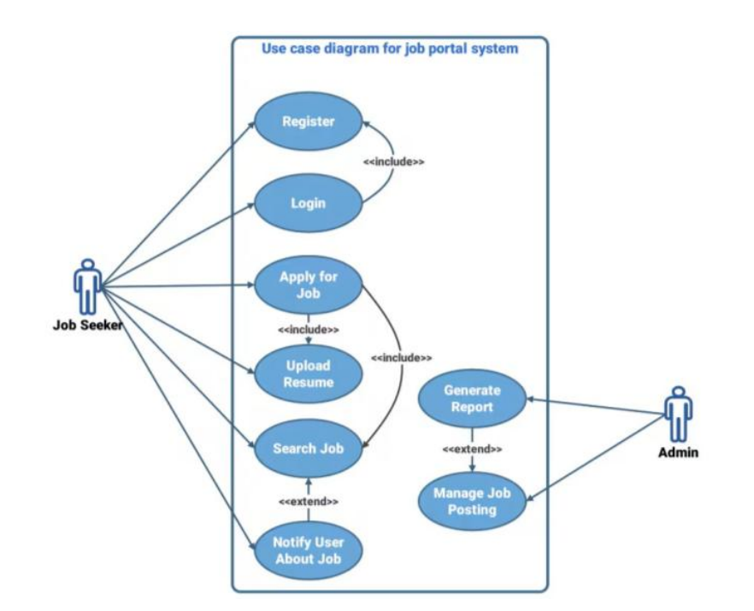
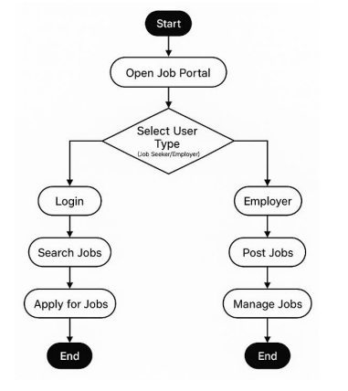
USE CASE DIAGRAM
ACTIVITY DIAGRAM

Slide 9
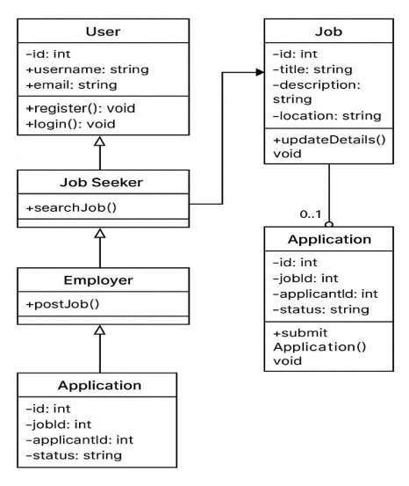
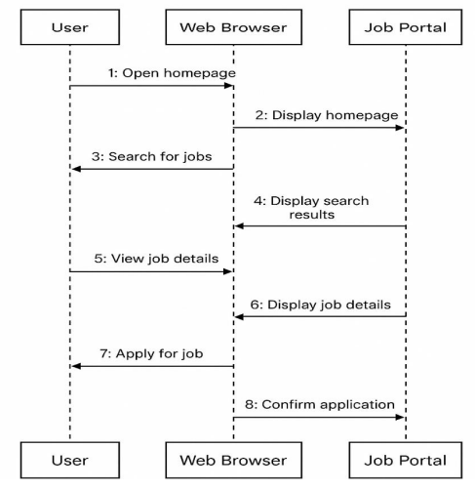
CLASS DIAGRAM
SEQUENCE DIAGRAM

Slide 10
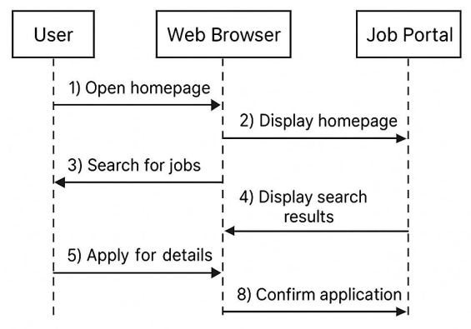
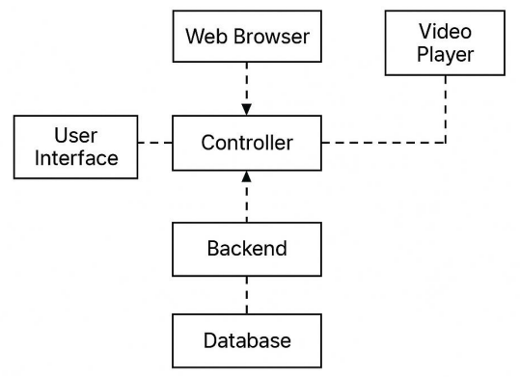
COLLABORATION DIAGRAM
COMPONENT DIAGRAM

Slide 11
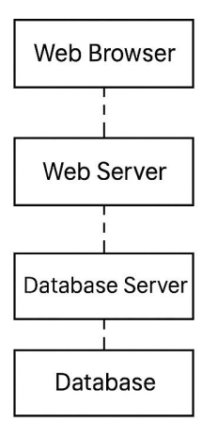
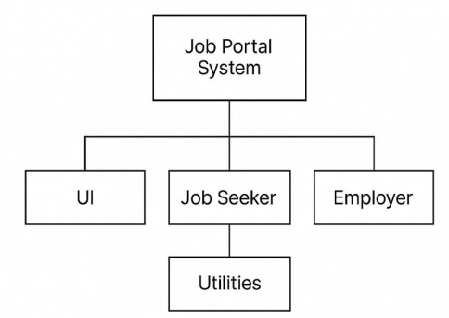
DEPLOYMENT DIAGRAM
PACKAGE DIAGRAM

Slide 12
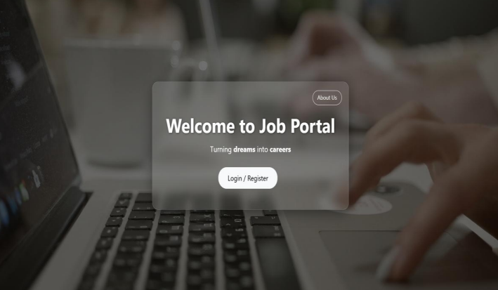
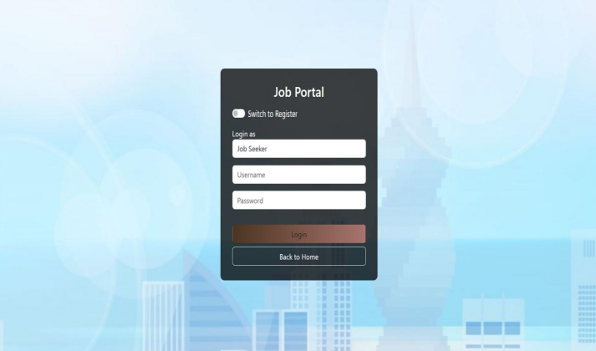
OUTPUT

Slide 13
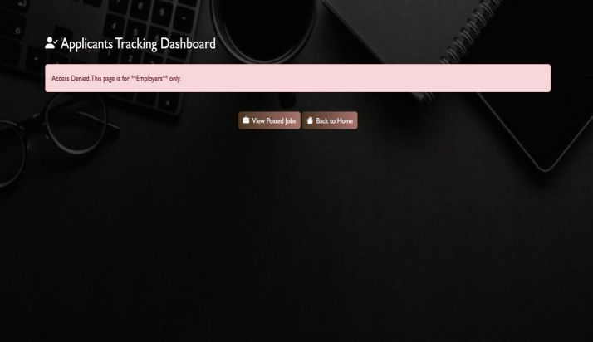
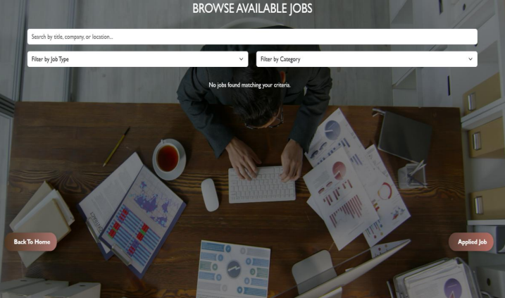
OUTPUT

Slide 14
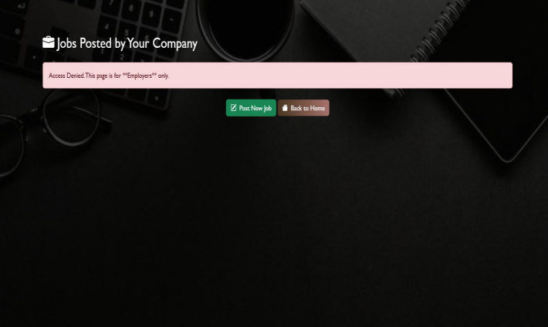
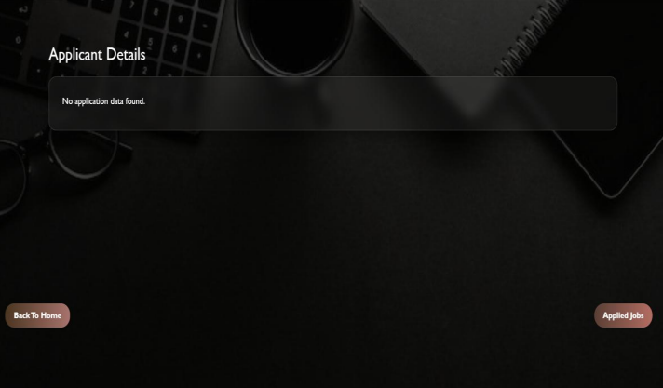
OUTPUT

Slide 15
CONCLUSION
The Job Application Management System simplifies and digitizes the entire recruitment process. It ensures efficiency, accuracy, and transparency between recruiters and applicants.
The project offers a scalable and secure platform for managing end-to-end hiring operations.
Future Scope : Integration of AI-based resume screening and chatbot support to enhance user experience and streamline recruitment.

